Slide 1
Political Dynamics in the Horn of Africa
Josef Woldense
jwoldens@indiana.edu

Slide 2
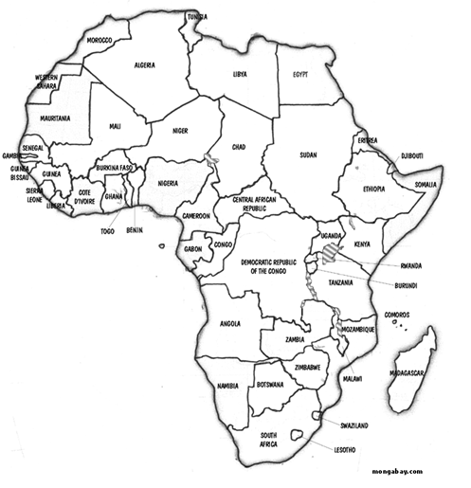
Isaias Afwerki
Piracy

Slide 3
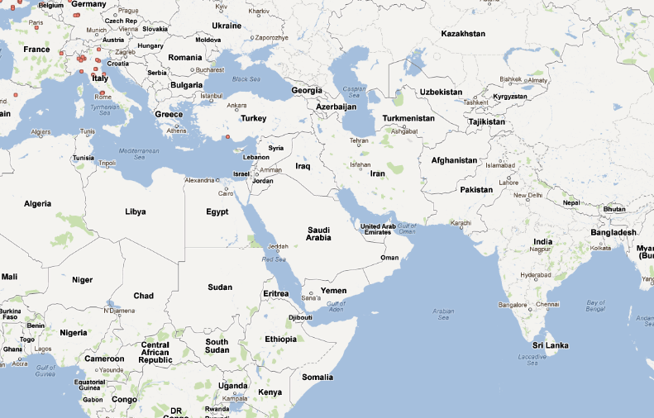

Slide 4
Eritrea
Djibouti
Ethiopia
Somalia

Slide 5
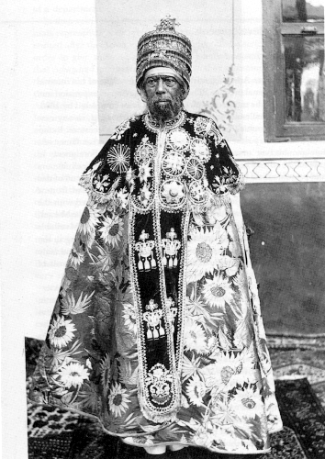
French
Italy
1889-1916
British
Italy

Slide 6
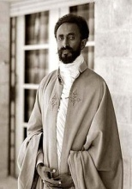
1920-1974

Slide 7
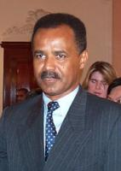
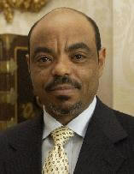
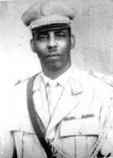
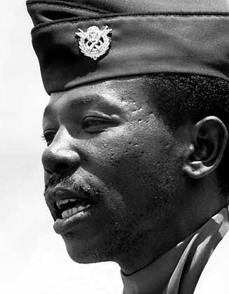
1974-Present
1975-present
1969-1990
Eritrean People Liberation Front (EPLF)
Tigray People Liberation Front (TPLF)
1974-1990

Slide 8
Organizations
Eritrea
Ethiopia
ELM→Eritrean Liberation Movement (1958-65)
ELF→Eritrean Liberation Front (1961-175)
EPLF→Eritrean Peoples Liberation Front
WSLF→Western Somalia Liberation Front
TPLF→Tigray Poeples Liberation Front
OLF→Oromo Liberation Front
EPRP→Ethiopian Peoples Revolutionary Party
EDU→Ethiopian Democratic Union
SALF→Somali Abo Liberation Front
IFLO→Islamic Front for the Liberation of Oromia
SLF→Sidama Liberation Front
Echat→Ethiopian Oppressed Peoples Struggle

Slide 9
1974-present
1975-present
1969-1990

Slide 10
PBS Documentary
EPLF short film
Double Standard Show 12.33min

Slide 11
Documentary on Ethiopia
Interview with the Prime Minister

Slide 12
BBC Documentary on Piracy
Ethiopia Invasion of Somalia
(15min)

