Slide 1
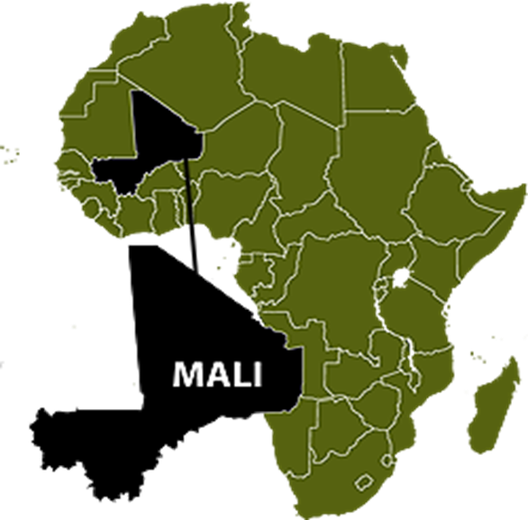
THE HISTORY OF ISLAM IN MALI: A personal experience
Presented by
Dr. Amadou Beidy Sow
Indiana University
African Studies

Slide 2
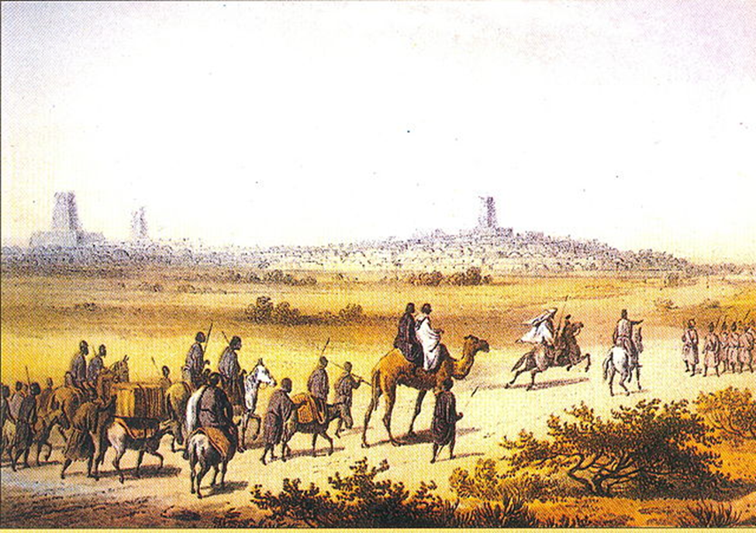
A Medieval Country
How did Mali get its name?
Where is Mali?
What are the different Religions in Mali?
What is Islam?
People of Mali
What is the Climate?

Slide 3
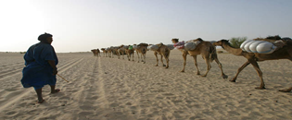
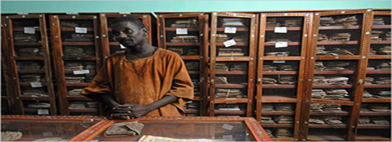
Mali Through Timbuktu
Where is Timbuktu?
How did Timbuktu get its name?
What is unique about Timbuktu?

Slide 4
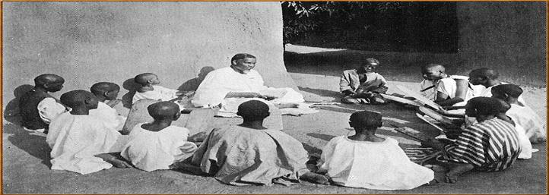
Being a Child in Mali
Being a child in a Muslim society (Mali)
Responsibilities of a child in a Moslem society(Mali)

Slide 5
Children and the Koranic Schools
Learn verses from the holy Koran
Help the Koranic teacher doing little works
Help the Koranic teacher’s wife/wives doing choirs
Door to door begging
Pray

Slide 6
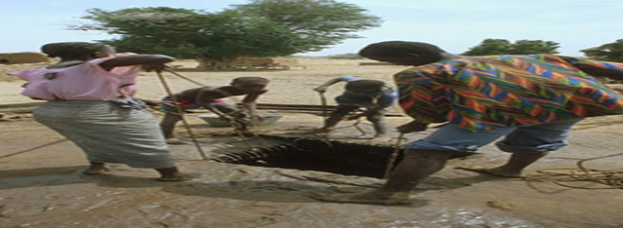
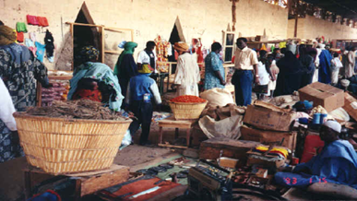
Helping parents
Do choirs in their own families
Draw water from the well
Buy products from the neighborhood store/grocery store or Market
Help father fixing the house (mud house)

Slide 7
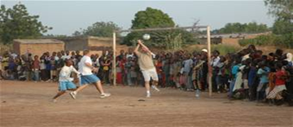
Entertainment
Play Football/Soccer
Watch a Football/Soccer game
Visit friends
Chat groups
Watch a football game

Slide 8
Ramadan
What is Ramadan?
What is Eid el Fitr (salifitini in Mali)
What is Eid el Kabir (saliba in Mali)

Slide 9
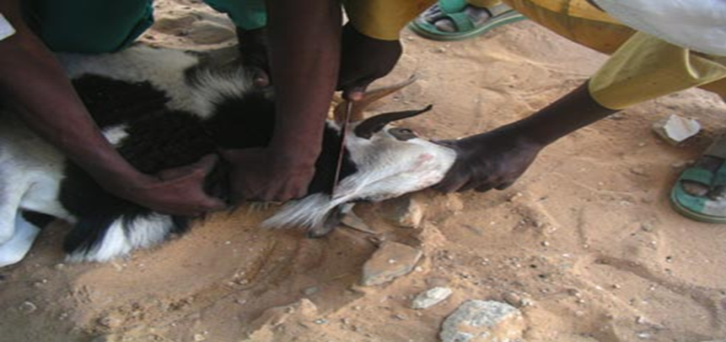
Sacrifices
Why do they slaughter a Sheep?
Who should make the Sacrifice?
When do they slaughter/sacrifice a sheep?
What do they do with the meat?
How do they slaughter the Sheep?
Who laughter the sheep?

Slide 10
Children and the Western Schools
What are Western schools?
What do Muslim parents think about Western Schools?
At what age do children start going to school?
Where are the schools located?
How children are taught in this new Schools?

