Slide 1
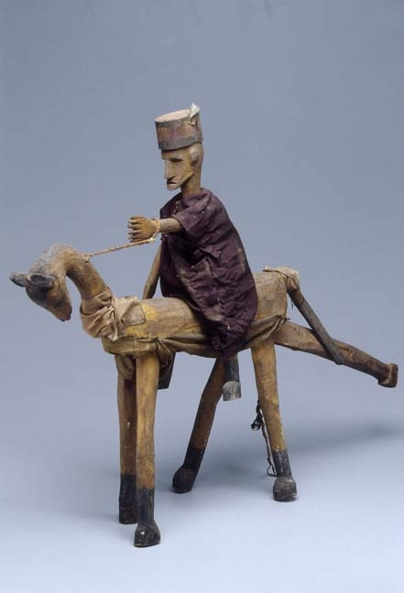
Bamanan Puppets: Transmitting Cultural Values through Performance in Mali
PRESENTED
BY
AMADOU BEIDY SOW, Ph.D.

Slide 2
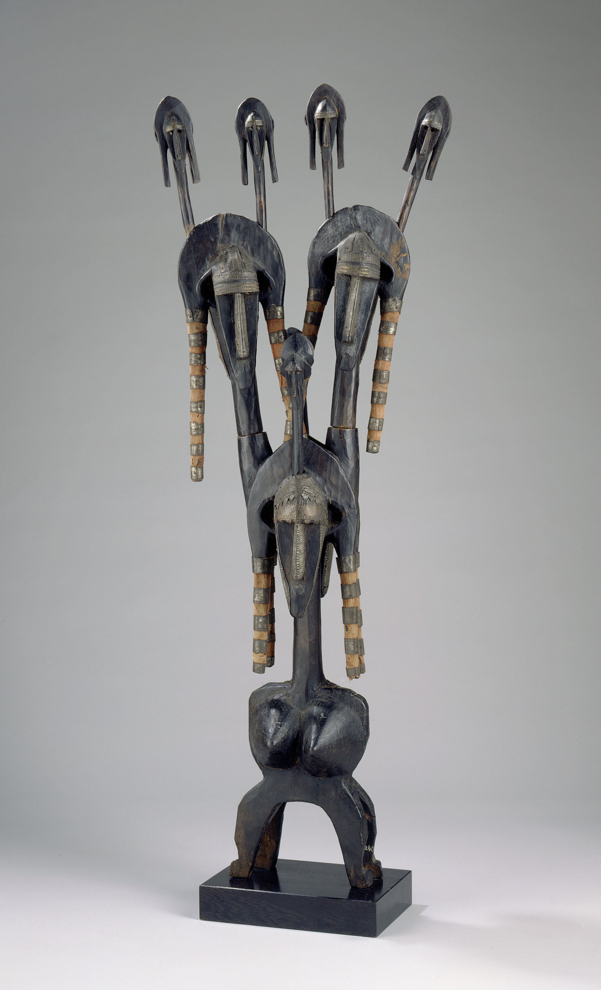
Literature
The literature is based on the Research of:
Mary Jo Arnold: Playing With Time: Art and Performance in Central Mali.
Pierre-Alain Uniack & Benoit Guit: Cheval du fleuve Niger: marionnettes Bozo et Bambara du Mali

Slide 3
Definitions
Puppets or Sogow in Bamanankan are:
Wooden statutes wrapped in shining cloths or metal objects.
The representation of Human beings
The representation of animals
The representation of objects

Slide 4
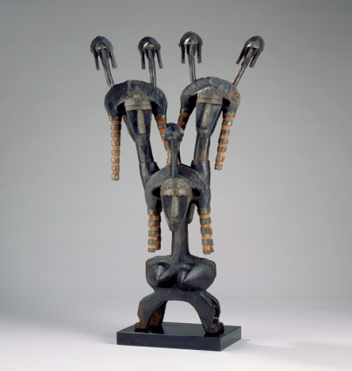
Origins and people
Origin
What people from Segu Segukaw say about the origin of puppets is that they cannot recall it, and that the puppets have been existing in Segu region for a long time.
The Arab explorer Ibn Battuta testified (1353) that he saw puppets in the court of King Souleyman (Masa Souleyman) in the Empire of Mali.
People
Bamanan
Maraka
Bozo
Somono

Slide 5
The objectives
Monica Blackmun Visona, Robin Poynor, Herbert M. Cole, and Michael D. Harris described puppets as “The human marionette head, known as the merenkun, was used in public presentations of satire mimicking a cast of stock characters, such as marabouts, misers, and foreign ethnic groups.”
They entertain
One time opportunity
They help to solve domestic, private, and political issues in the Bamanan society

Slide 6

The difference of puppets
The difference of puppets is based on the profession of a particular ethnic group in Mali.
Bamanan people (farmers, hunters, and blacksmiths)
-Their puppets are cows, donkeys,
antelopes
Bozo/Somono people (fishermen)
-Aquatic animals (fish, hippo, crocodile
etc.)
Maraka/Sarakole people (traders, farmers)
-Donkey and horse

Slide 7
Choice of puppets
The choice of puppets during a celebrating always depend on the topic at stake. (to talk about domestic quarrel they pick a man and woman).
http://www.youtube.com/watch?v=hRgun--0BW8

Slide 8

Belonging and use
Puppets belong to a particular community or an individual group of young men’s called tᴐn.
Puppets do not belong to a secret society therefore open to public curiosity.
Puppets are used by a men’s tᴐn in harmony with a women’s tᴐn.

Slide 9

When does the dance occur?
When does the dance occur depends on a few factors:
After harvest
After the fishing season
It generally depends on the importance of the issue.

Slide 10
Present meaning of Puppets
In the past even though puppets were not sacred or secret, they were performing for a special reason.
Nowadays puppets are just entertaining the public.
They perform at any time .
http://www.youtube.com/watch?v=NTxPxt7AOtM

Slide 11



