Slide 1
Antislavery Movements in the Islamic Republic of Mauritania
Katherine Wiley
Department of Anthropology
Indiana University
katwiley@indiana.edu

Slide 2
Slavery in Mauritania
Notes:
We’ll begin with a brief video on slavery in Mauritania from 2009 and then examine the history of slavery there, discuss what it looks like today, and talk about movements that work against this. http://www.youtube.com/watch?v=7Uzv5hURAXQ

Slide 3
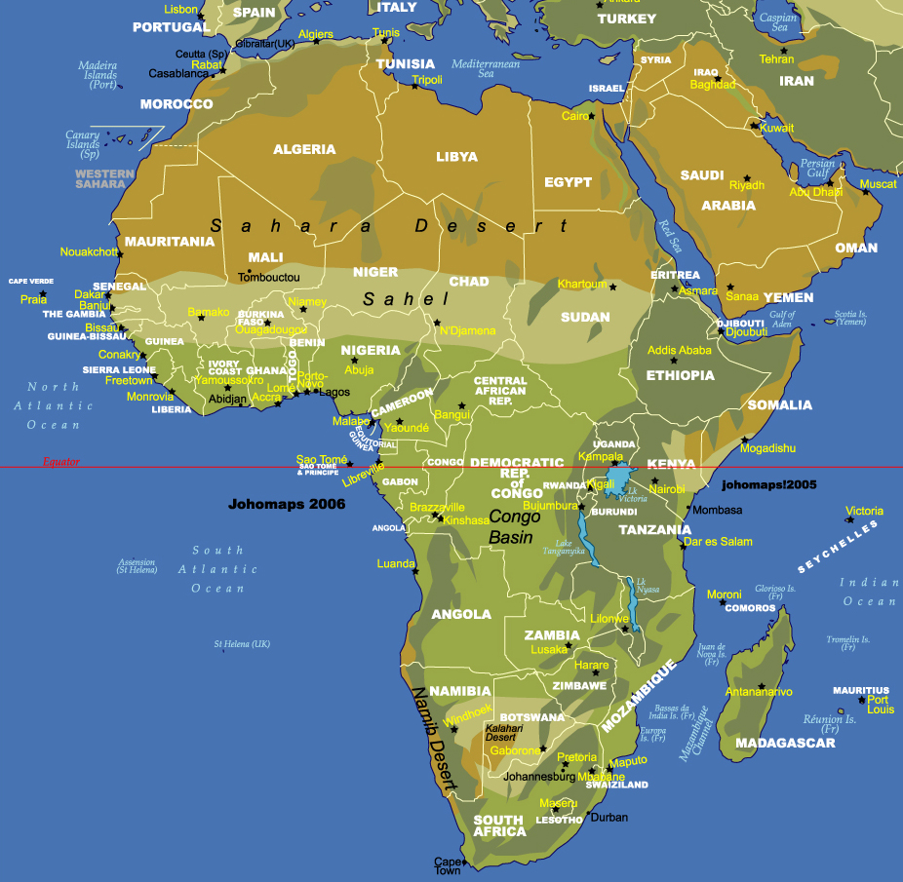
http://johomaps.com/af/afrique1.html
Notes:
Mauritania is found in Northwest Africa. It is one of the places where West Africa and North Africa meet. For centuries traders, travelers, and religious people have migrated throughout this region.

Slide 4
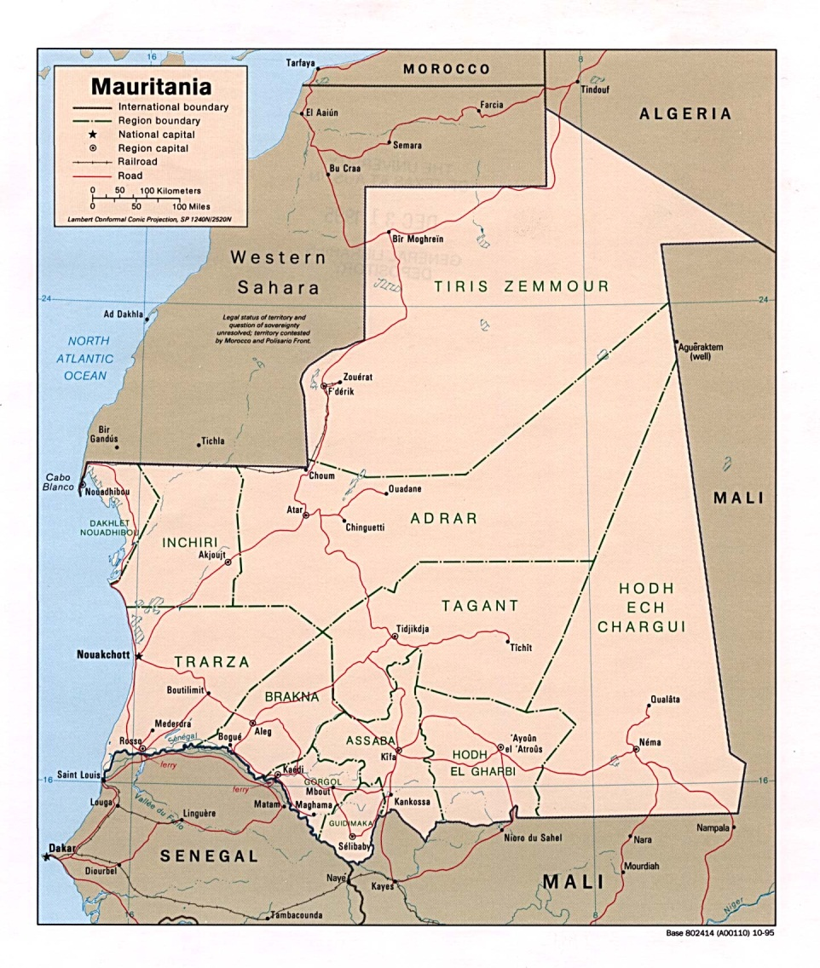
Who lives in Mauritania?
Bidhan (people of Arab and Berber descent)
Haratine (former slaves or descendants of slaves of Bidhan)
sub-Saharan African groups (Pulaar, Wolof, Soninke)
Notes:
Mauritania’s population reflects its position between North and West Africa. It is composed of three major groups of people:
the Bidhan. Bidhan are generally of Arab or Berber (a North African group) descent. Throughout Mauritania’s history, they have tended to dominate the country’s political and economic system. All of Mauritania’s presidents since independence from France in 1960 come from this group.
the Haratine. Haratin are people who are either former slaves or descendants of slaves. They share a common language and many cultural practices with the Bidhan and many are of black African descent.
Members of sub-Saharan African groups including Pulaar, Wolof, and Soninke people. These groups speak their own languages and elements of their cultures are different from Bidhan or Haratine culture. Some have been living in Mauritania for centuries, especially along the southern border which is fertile due to the Senegal River. Others have come more recently looking for work or for chances to get to Europe. It is important to note that Pulaar, Wolof, and Soninke society is also hierarchical and many higher caste members also had slaves. This presentation focuses on slavery amongst the Bidhan and Haratine. Also note that race is complicated in Mauritania. While many Haratine are of African descent and many Bidhan are of Arab descent which social category a person belongs to often can not be identified by their apparent skin color (due to years of intermarriage between groups etc.).

Slide 5
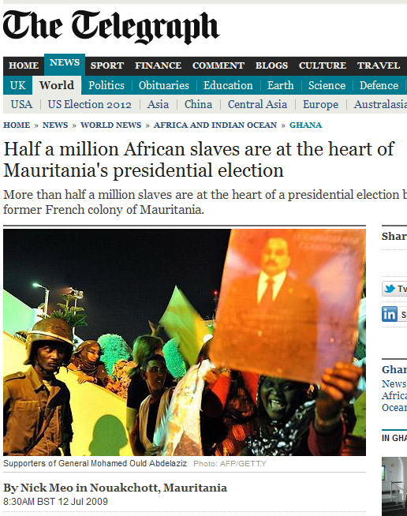
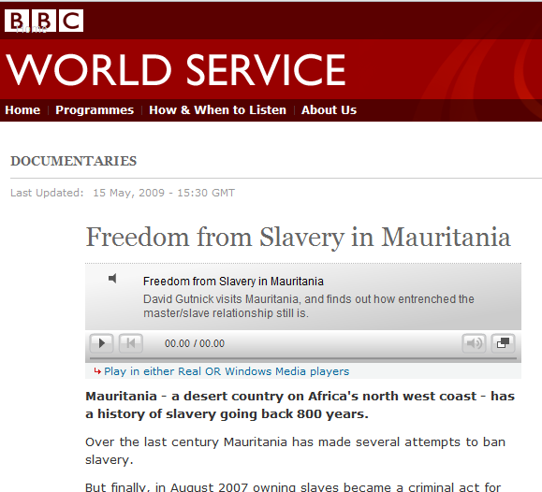
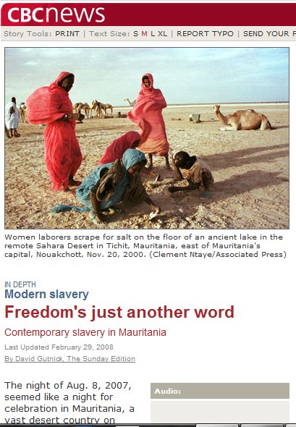
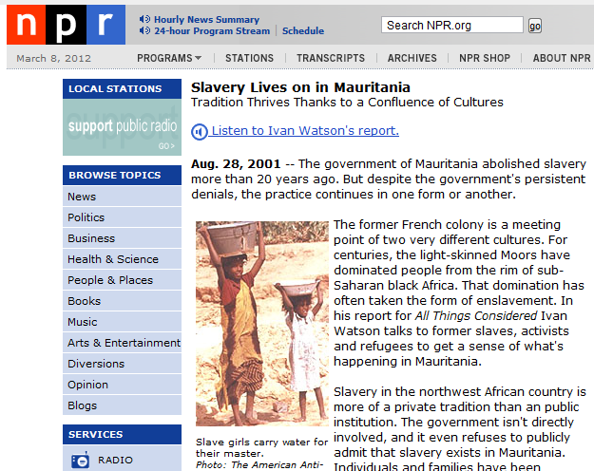
What is the situation like today?
Notes:
Much of the (limited) attention that Mauritania receives in the US media is concentrated on slavery. Here are some examples of stories that students might like to read.
CBC (Canada) article: ‘Freedom’s just another word: Contemporary slavery in Mauritania.’ Note that this article also includes 22 minutes of audio on modern slavery in Africa. http://www.cbc.ca/news/background/slavery/mauritania.html
The Telegraph (Britain): “Half a million African slaves are at the heart of Mauritania’s presidential election” : http://www.telegraph.co.uk/news/worldnews/africaandindianocean/ghana/5805113/Half-a-million-African-slaves-are-at-the-heart-of-Mauritanias-presidential-election.html
This is an NPR article (along with an audio story) from 2001 when Mauritania was still under the rule of a dictator. This story gives a more nuanced picture of slavery in Mauritania than many of the others: http://www.npr.org/programs/specials/racism/010828.mauritania.html
This is a 22 minute audio story from the BBC on slavery in Mauritania. It is also more nuanced that some of the other reports. http://www.bbc.co.uk/worldservice/documentaries/2009/05/090515_slaverydoc.shtml
Here is a ten minute documentary that documents the experience of some former slaves: http://www.youtube.com/watch?v=DLJqG_X6UGs

Slide 6
Problems with this reporting
Misunderstanding or reduction about what being a slave means
Exaggerating Haratine misery and poverty
Overlooking the fact that it’s common for Mauritanians to have servants who are paid and can (and often do) leave their jobs
May confuse unfair labor and wage policies with slavery
Notes:
Articles like these can be problematic, however. While most Mauritanians agree that slavery exists in some form there, often these reports overestimate the numbers – e.g. indicating that all Haratine are still slaves, which is untrue. Many Haratine would be very offended if they were to be called slaves.
They also often insinuate that all Haratine are impoverished. This is also not true. Many Haratine are making good livings in Mauritania and hold important positions in the government and business sector. The runner-up in the 2009 Presidential elections was Haratine. It is true that Bidhan still generally dominate these sectors, but Haratine are making great strides. Many, many Haratine would be offended if they were called slaves. It is also untrue that all (or most) Haratine are illiterate. Many are highly educated. Some are professors at the university and others study abroad. In fact, many Bidhan and Haratine of older generations are illiterate because schooling only became compulsory recently. It is also the case that many Bidhan are poor.
These articles may often confuse servants with slaves. Most middle-class and upper-class families in Mauritania have servants who typically come from the Haratine or sub-Saharan African ethnic groups. They generally assist with cooking and cleaning. They are paid (though not much) and provided with food and clothes. They can quit their jobs (and often do). It is very common for Haratine who are doing alright financially to have servants.

Slide 7
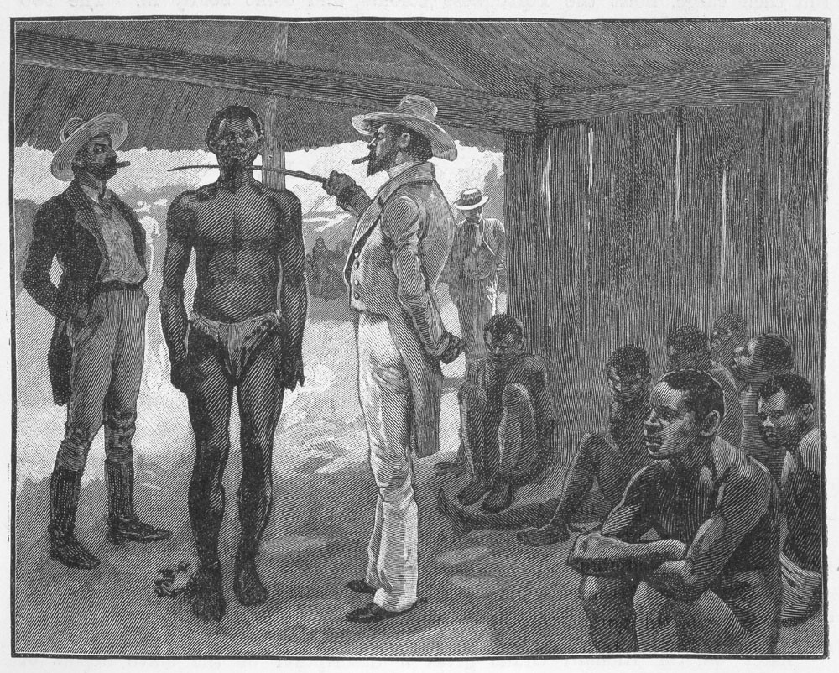
What do we mean by “slave” in Northwest Africa?
Buying Slaves, Havana, Cuba, 1837; Image Reference mariners10, as shown on www.slaveryimages.org, compiled by Jerome Handler and Michael Tuite, and sponsored by the Virginia Foundation for the Humanities and the University of Virginia Library.
Notes:
What did/ does it mean to be a slave in Africa? What do students think about this?
Do they think this might have meant something different than what being a slave meant in the United States? What ideas do they have about how these practices could have differed?
Note that this presentation focuses on slavery primarily in Mauritania and the surrounding regions. The historical experiences of slavery differed greatly across the African continent.
This picture is from a book published by Arthur Thomas Quiller-Couch in 1895 and depicts slave trading in Cuba. It’s an artist’s rendering and not an eye-witness drawing. The image (and others of slave buying in the Americas) can be found at http://hitchcock.itc.virginia.edu/Slavery/details.php?categorynum=6&categoryName=Slave%20Sales%20and%20Auctions:%20African%20Coast%20and%20the%20Americas&theRecord=44&recordCount=75

Slide 8
What do we mean by “slave”?
In northwest Africa where kin relations are very important, many argue a slave is someone who is excluded from kin relations
There were many different kinds of dependents in Mauritania
Slaves had different statuses (e.g. those who had been captured vs. those born into families)
Notes:
Genealogy is a major way through which people establish belonging in this region of Africa. Who people descended from affected their identities and the clans or federations of clans that they belonged to. It also often had implications for whom they would marry (since people often married others of similar social status). In this region, slaves were removed from kin relations. Their children would not continue their lineages, but would rather be the property of their masters. Even if slaves were freed, the lack of kin could be very challenging as they might not have people whom they could live with or who would help them to find work, etc.
Being financially successful in Mauritania was often linked to one’s ability to maintain dependents. These included slaves, but also included other groups. Historically, Mauritania has been a very hierarchical society with a caste system that places some people above others based upon their birth status. For example, Bidhan ‘warrior’ groups often collected money and goods from Bidhan religious groups in turn for their protection. Slavery, then, may be thought of as one kind of dependence on a continuum of dependence. Some scholars argue that many slaves did not leave their masters after independence because of the opportunities for movement within this system (e.g. one could become a higher level of dependent).
Slave experiences in this region were diverse. Some slaves had higher status than others and conducted more valued tasks. Some slaves left their masters for many months each year to go with their masters’ trade caravans and to conduct business for them. Others rarely lived with their masters, but rather farmed their land; their masters would come at the time of the harvest to collect a share of it. Some women became ‘house’ slaves, taking care of their masters’ children and sometimes even having children themselves with their masters. Typically, these children would be freed after the death of the master (note that free or slave status in Mauritania comes from the mother – i.e. if a woman is a slave her children will be slaves even if the father is free).

Slide 9
How many slaves were there in French West Africa?
In various parts of the Sahel in 1904, approximately 40 percent of population was slaves
In Kayes, 30,000 of the population of 71,421 were slaves (42 percent)
The numbers of slaves varied throughout the French colony and may have been underreported
Notes:
The Sahel is a semiarid region in West Africa that begins in southern Mauritania. The numbers of slaves varied throughout the Sahel, with there being more in some regions than others.
These numbers are drawn from the following book: Martin A. Klein 1998. Slavery and Colonial Rule in French West Africa, African studies series. New York: Cambridge University Press. Klein emphasizes that it is difficult to estimate what the actual slave population was since, although these numbers are based upon French slave censuses, often owners underestimated the number of slaves that they owned.
Kayes is a city in Mali that is close to the border with southern Mauritania.

Slide 10
History of slavery in Northwest Africa: Early slave trade
Most slaves were captured through raiding
Others were taken to pay debt or as criminal penalties
There was some voluntary enslavement (if people were severely strapped financially)
Notes:
In the pre-colonial period there were often wars between different groups that could generate slaves. The spread of Islam, sometimes through violent means, also generated captives who would often be enslaved. As the slave trade slowed down in the Americas, this left increased the numbers of slaves in Africa which helped the colonial economy expand since they provided cheap labor. Most slaves came from black African groups.
This website has pictures of pre-colonial African life with pretty good descriptions. Other parts of the site have images of slavery in the United States, capture of slaves in Africa etc.: http://hitchcock.itc.virginia.edu/Slavery/return.php?categorynum=2&categoryName=Pre-Colonial%20Africa:%20Society,%20Polity,%20Culture

Slide 11
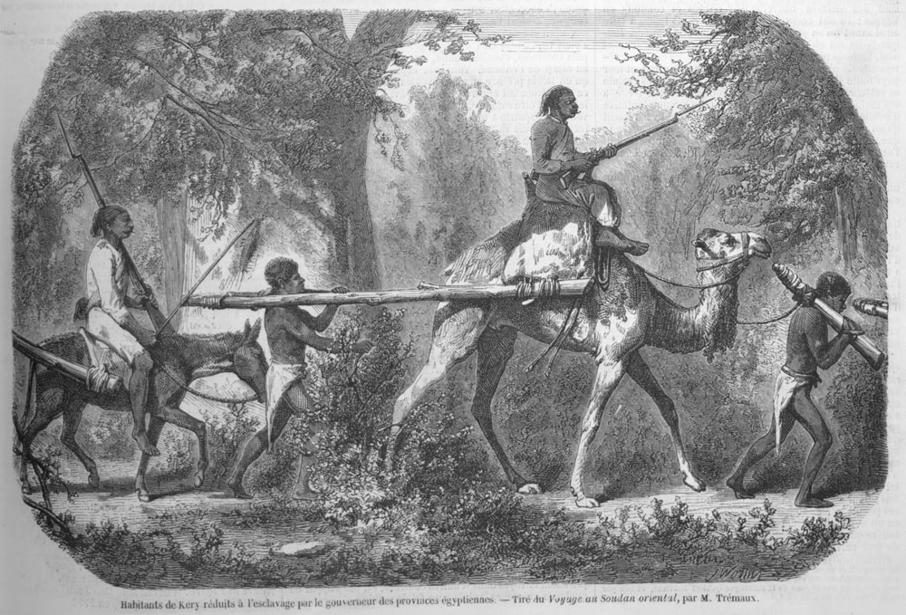
“Enslaved Africans in a Coffle, Eastern Sudan, 1848; Image Reference illustration 369, as shown on www.slaveryimages.org, compiled by Jerome Handler and Michael Tuite, and sponsored by the Virginia Foundation for the Humanities and the University of Virginia Library."
Notes:
This image depicts enslaved Africans being taken from the Sudan to Egypt. It is taken from an article by Pierre Trémaux on his travels there that was published in 1856. While slavery had been declared illegal in Egypt in 1846, similar to West Africa, it continued well past then.
Image is from: http://hitchcock.itc.virginia.edu/Slavery/details.php?categorynum=3&categoryName=Capture%20of%20Slaves%20and%26%2365533%3B%26%2365533%3B%20Coffles%20in%20Africa&theRecord=23&recordCount=43

Slide 12
History of slavery in Northwest Africa: French colonial policy
Notes:
The purple portions of this map depict French colonial Africa. The French penetrated Mauritania fairly late as compared to their other colonies in Africa. It was recognized as a civil territory in 1903, but resistance in the north continued up until 1912 and in some places into the 1920s.

Slide 13
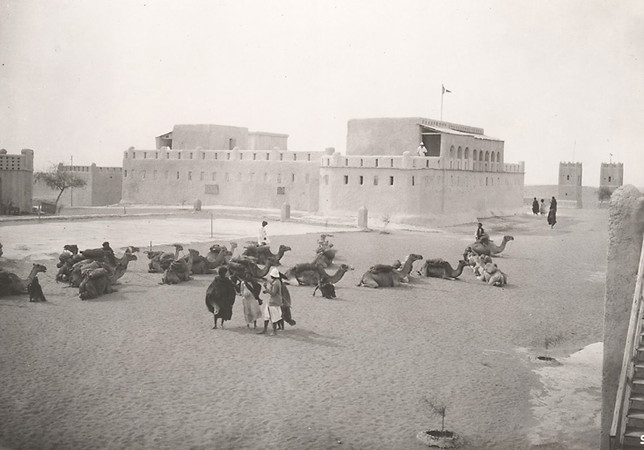
Photo by Odette du Puigaudeau; “Poste de Boutilimit. Arrivée d’une caravane [The post of Boutilimit. Arival of a caravan]. From the Archives nationales d’outre mers; FR CAOM 30Fi39/67
Notes:
This image depicts the French governing post at Boutilimit, a town about 100 kilometers south of today’s capital (Nouakchott). In this picture, taken in 1934 by a French traveler (Odette du Puigaudeau) a caravan is arriving.

Slide 14
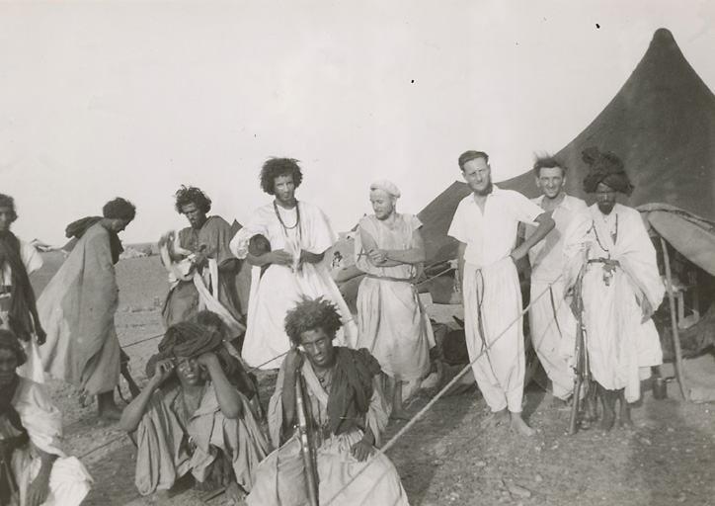
Anonymous. 1945. “Au campement du groupe nomade d’Akjoujt [In the camp of the nomadic group of Akjoujt].” In Archive nationales d’outre-mer. FR CAOM 30Fi35/44
Notes:
Here is another picture of French with some nomadic Mauritanians (mostly Bidhan). This was taken in 1945.

Slide 15
French colonial antislavery policy
The French were largely ambivalent about abolishing slavery in Mauritania
They feared that ending slavery would damage their relations with allies and hurt the economy
They said they wanted to avoid disrupting local customs
They sometimes justified their colonial expansion as a way to abolish slavery
Notes:
Despite the fact that slavery had been declared illegal in France in 1848, the French were largely ambivalent about ending it in their colonies. This was largely because they recognized that they had to appease local leaders in order to maintain the alliances with them that allowed them to hold onto their territory. Many of these local leaders owned slaves and the French feared that banning slavery could diminish their support for the colonial project. However, since in France itself the abolition movement was strong, colonial administrators often had policies in place to end slavery in the colonies which they did not actually enforce. A 1881 law that gave freedom to slaves who sought protection in colonial administrative centers and another in 1903 that declared that slavery would have no legal status in the colony were also not strictly enforced.
The French were also concerned that ending slavery might hurt the colonial economy and trade since slave labor was used in harvesting cash crops such as gum arabic. The French also sometimes used slave labor in their own colonial construction projects.
The French also said that they did not want to upset local customs such as slavery. Many had racist views themselves, often viewing Africans as being below them on what they thought of as an evolutionary scale of social evolution (in which Europeans were more ‘evolved’ than Africans) and thus not worthy of action.
The French colonial administration did eventually crack down more on slave trade (partly under pressure from those in France), but the slave trade continued into the 20th century. While they did eventually lesson the slave trade in the early 1900s, domestic slavery persisted.

Slide 16
Slave agency
Despite the ambivalence of the French and local leaders, many slaves managed to shift their own statuses by
Running away
Working in wage labor (provided by French)
Joining religious orders
Renegotiating relationships with masters
Buying their freedom
Fighting in French wars
Being freed by their masters
Notes:
Often slaves sought their own freedom, despite a lack of antislavery movements. One of the major challenges of leaving their masters was finding a way to earn an income themselves since they did not own land and might not have relatives elsewhere who could support them or help them to find jobs.
Some ran away and new paid jobs that were created under the French facilitated this as they provided ways through which people could earn their own incomes.
Some slaves joined religious orders seeking their freedom and some of these orders would give them land which provided them with a means of making their own money.
Others renegotiated relations with their masters, perhaps moving elsewhere but giving them a portion of their harvest and being allowed to accumulate wealth themselves. In many cases they could buy their freedom, but this was often extremely expensive.
Some slaves who fought for the French in WWI and II were freed by the French or came back with new skills and ideas and thus were less inclined to stay with masters.
Slaves would sometimes be freed if they achieved certain levels of Islamic learning such as memorizing the Koran since Muslims are not supposed to enslave other Muslims.
Note that often ex-slaves still retained relationships with their former masters. This is often still the case in Mauritania today, where slaves and their ex-masters may still be members of the same sociopolitical units (clans and federations of clans) and may also exchange gifts with each other at holidays and ceremonies.

Slide 17
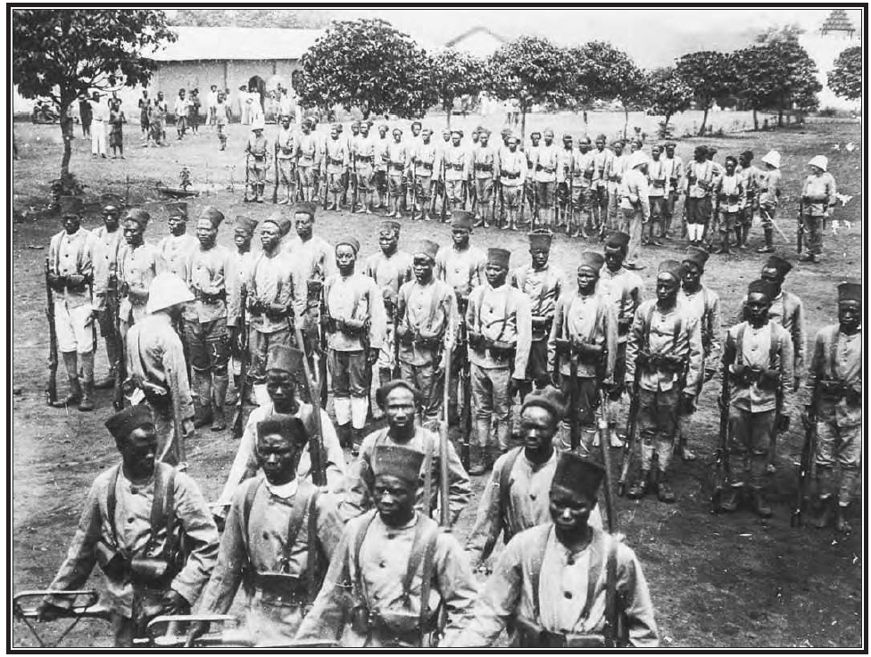
http://colonialwarfare18901975.devhub.com/blog/570966-tirailleurs-senegalais/
Notes:
Here is an image from the 1930s of Africans recruited to fight in French wars: http://colonialwarfare18901975.devhub.com/blog/570966-tirailleurs-senegalais/
Many of these men fought in Europe. The French did recruit slaves (and ex-slaves) to join their army. Sometimes slaves would be freed upon joining although this could be complicated upon their return home. Others were not freed, but came back demanding greater freedom and/ or with skills that enabled them to support themselves.

Slide 18
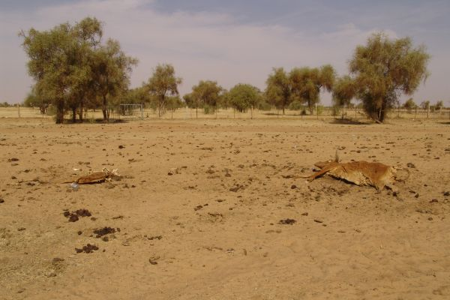
History of slavery in Mauritania post-independence
We can’t really talk about an end to slavery, but rather a gradual transition away from it
Notes:
In Mauritania, environmental factors, especially severe drought in the late 1960s and early 1970s were linked to the diminishment of slavery. These droughts caused slaveholders to lose wealth since large proportions of their herds died. Many people lacked the funds to adequately care for their own families, let alone dependents like slaves so, during this period, many slaves moved to urban areas, finding ways to make their own livings and gaining de facto independence. Earlier droughts in Mauritania in the 1920s and 1930s also led slaves to leave their masters (or their masters to abandon them).
This photo is of drought conditions in 2011 in Mauritania. It was taken from the World Food Program website which has information about the current drought conditions: http://www.wfp.org/countries/Mauritania/Media/Mauritania-Suffers-from-Drought

Slide 19
Post-independence policy on slavery
1961 constitution declares that all citizens are equal
Slavery officially declared illegal in Mauritania in 1980 (enforced in 1981 law)
2007 law condemns slavery as a criminal act and introduces mechanisms to punish those who practice it
Notes:
The 1961 constitution didn’t officially condemn slavery, but rather said that it would comply with various declarations of human rights which called for the equal treatment of all citizens.
The 1980 declaration and subsequent 1981 law that declared slavery illegal were largely symbolic. While slavery continued to diminish during this period, there were few legal measures in place to reinforce it.
Although the 2007 law declared that slavery is a criminal act, many antislavery activists complain that it is rarely enforced.

Slide 20
El-Hor (Freedom) Movement
Haratine political movement that formed in 1970s
Sought increased rights and recognition for Haratine
Charter promises to fight against economic exploitation, promote mass education, and support property and marriage rights
Made gains in municipal elections
Notes:
El-Hor was the first Haratine political movement. It sought increased rights and recognition for Haratine in Mauritania. It led public protests against slavery and some of its members did win elected positions. It was also instrumental in getting slavery declared illegal in Mauritania in 1980.

Slide 21
Principles of El-Hor
Argued that a distinct Haratine ethnic group exists that is separate from Bidhan (vs. Haratine who wanted to assimilate with the Bidhan)
Not all Haratine were united behind principles of El-Hor
Notes:
Not all Haratine agreed with the principles of El-Hor, particurally its insistance that the Haratine are a distinct ethnic group that deserves recognition. Many Haratine argued that this was not the case, but that they were actually Bidhan, like their masters, and thus they wanted to integrate into Bidhan forms of social organization (tribes, clans, etc.). These debates continue in Mauritania today.

Slide 22
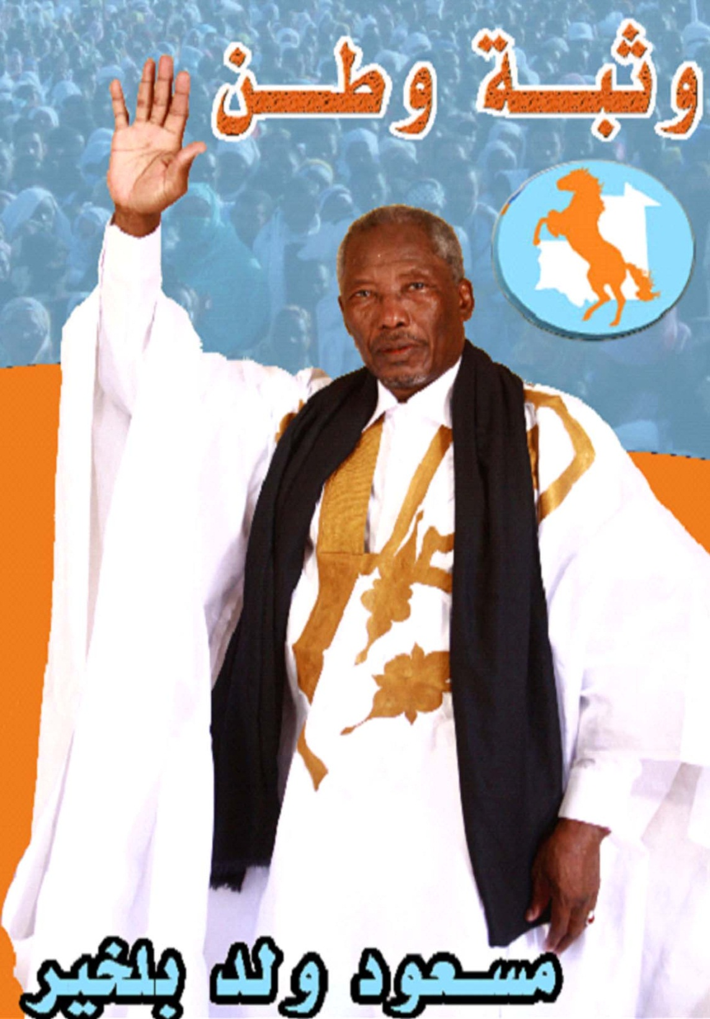
IMAGE OF EL-HOR
Notes:
Messaoud ould Boulkheir was one of the founders of el-Hor. Although the group eventually disbanded shifting into other political parties, he remained active in politics. Openly speaking about his slave past, he was the runner-up in the 2009 presidential elections and currently is the president of the National Assembly in Mauritania.

Slide 23
El-Hor methods
Carry out series of demonstrations for equality
In 1980 protest selling of woman in north; several leaders are arrested and tortured
Their imprisonment leads to much international attention which may have contributed to government reforms
Notes:
Government reforms in the early 1980s included land reform, a push for more inclusive and widespread education, and a literacy program. It is important to note that much of el-Hor’s success came not from working with the national government, but rather from attention it attracted from the international community (a new government, recently installed after a military coup, sought approval of the international community).

Slide 24
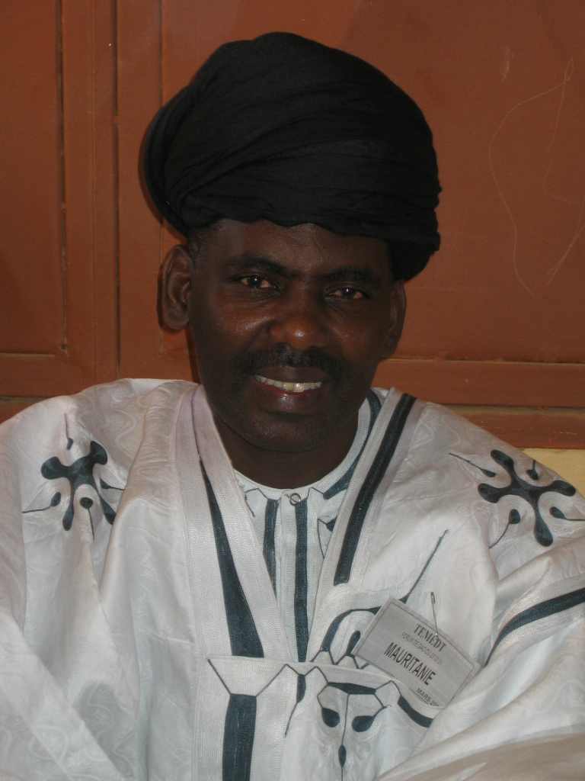
Later Movements
Many private organizations have missions to fight against slavery today
SOS Esclaves (SOS slaves)
Initiative for the Resurgence of the Abolitionist Movement in Mauritania (IRA)
Notes:
Many antislavery movements continue to work in Mauritania today. Most of these are not political parties the way El-Hor was (though they may be affiliated with political parties). They work to raise awareness about slavery in Mauritania both within and outside of the country. Many of them have links with international antislavery organizations that they receive funding and support from.
The man pictured is Biram Dah ould Abeid who is the president of IRA.
This is a story about a man involved in SOS Esclaves who is Bidhan. http://web.archive.org/web/20060811200908/http://www.iabolish.org/activist_ctr/abolitionists/abdel-nasser-ould-yessa.html

Slide 25
One incident
December 2010: anti-slavery organization (IRA) identifies two young, female slaves in Nkt
IRA takes them away from their masters
Some of the IRA activists are jailed when protesting during the trial (they are later released); the slave owner is sentenced to six months in prison
Many underage domestic workers are let go across Mauritania
Notes:
The slaves in question were young girls of 10 and 14 who were not attending school. They were working for a family in Nouakchott. Some Mauritanians disputed the fact that they were slaves, saying that they were paid servants who were sent by their parents to work for this family. IRA (antislavery organization) takes the girls away from the people who they were working for.
Here is an article about this incident: http://www.antislavery.org/english/press_and_news/news_and_press_releases_2009/120111_three_antislavery_activists_jailed_in_mauritania.aspx
And another one: http://www.magharebia.com/cocoon/awi/xhtml1/en_GB/features/awi/features/2011/01/18/feature-03
Many families let young maids go after this incident, fearing that they would be accused of having slaves. This article addresses that issue: http://www.magharebia.com/cocoon/awi/xhtml1/en_GB/features/awi/reportage/2011/04/15/reportage-01
This incident and the resulting letting go of domestic servants was very controversial in Mauritania. Sadly, many poor families depend on this kind of work to get by, even if it is poorly paid. They worried about how they would survive if their daughters could not work. Young women have few income earning opportunities beyond working as domestic servants. The arrest of the activists by the government also demonstrates its ambiguous stance against slavery. The activists were held in jail, but were eventually released.

Slide 26
Complications and Challenges
Difficulty of defining what it means to be a slave
Fact that antislavery groups attract many funds from international donors
Continued lack of nuance in understanding of what it means to be Haratine or Bidhan
Increased emphasis on human rights in general would be positive step
Notes:
As this presentation has discussed, what it means to be a slave in Mauritania is complicated and often blurs with conditions of economic exploitation in general, such as being paid low wages.
Many people in Mauritania argue that organizations that fight slavery often exaggerate the numbers of slaves and terrible conditions of slavery in order to attract international attention and funds. While not saying that these organizations do not care about these issues, this does seem to be somewhat the case.
As I’ve said earlier, there are many poor Bidhan and rich Haratine. The coverage of this issue is often problematic in that it assumes that these groups are homogeneous with all Haratine being poor and disadvantaged.
Many of these issues speak to larger problems in Mauritania (that are true elsewhere, of course) including economic inequality, widespread poverty, lack of employment opportunities or education. Stricter attempts to ease some of these problems would hopefully diminish the conditions that force many young (and old) people to work for low wages in difficult professions.

Slide 27
Notes:
In March 2012, CNN aired a video about slavery in Mauritania as well as launched many articles about it. While there are problems with the reporting (some of which you will hopefully identify after this presentation), the video and website are certainly worth examining with students. They can be found at:
http://thecnnfreedomproject.blogs.cnn.com/
http://www.cnn.com/interactive/2012/03/world/mauritania.slaverys.last.stronghold/index.html

Slide 28
Resources
UT Austin curriculum on comparative systems of slavery (in Haiti, East Africa, Egypt, etc.)
http://www.utexas.edu/cola/orgs/hemispheres/curriculum/slavery.php
PBS curriculum on slave trade in Ghana
http://www.pbs.org/wonders/Classrm/lesson3.htm
Comprehensive overview of slavery in Africa
http://autocww.colorado.edu/~blackmon/E64ContentFiles/AfricanHistory/SlaveryInAfrica.html
Notes:
Though there are more resources on the Atlantic Slave trade available than on slavery in Africa, but here are two curriculum that focus on slavery within Africa as well as a website that offers a comprehensive overview of this topic.

Slide 29
Thank you! Please feel free to contact me with any questions. katwiley@indiana.edu

